Slide 1
Case Study 1 – Exploratory Data Analysis
Prepared by Andrew Yule, John Worrall, and Andrew Walch

Slide 2
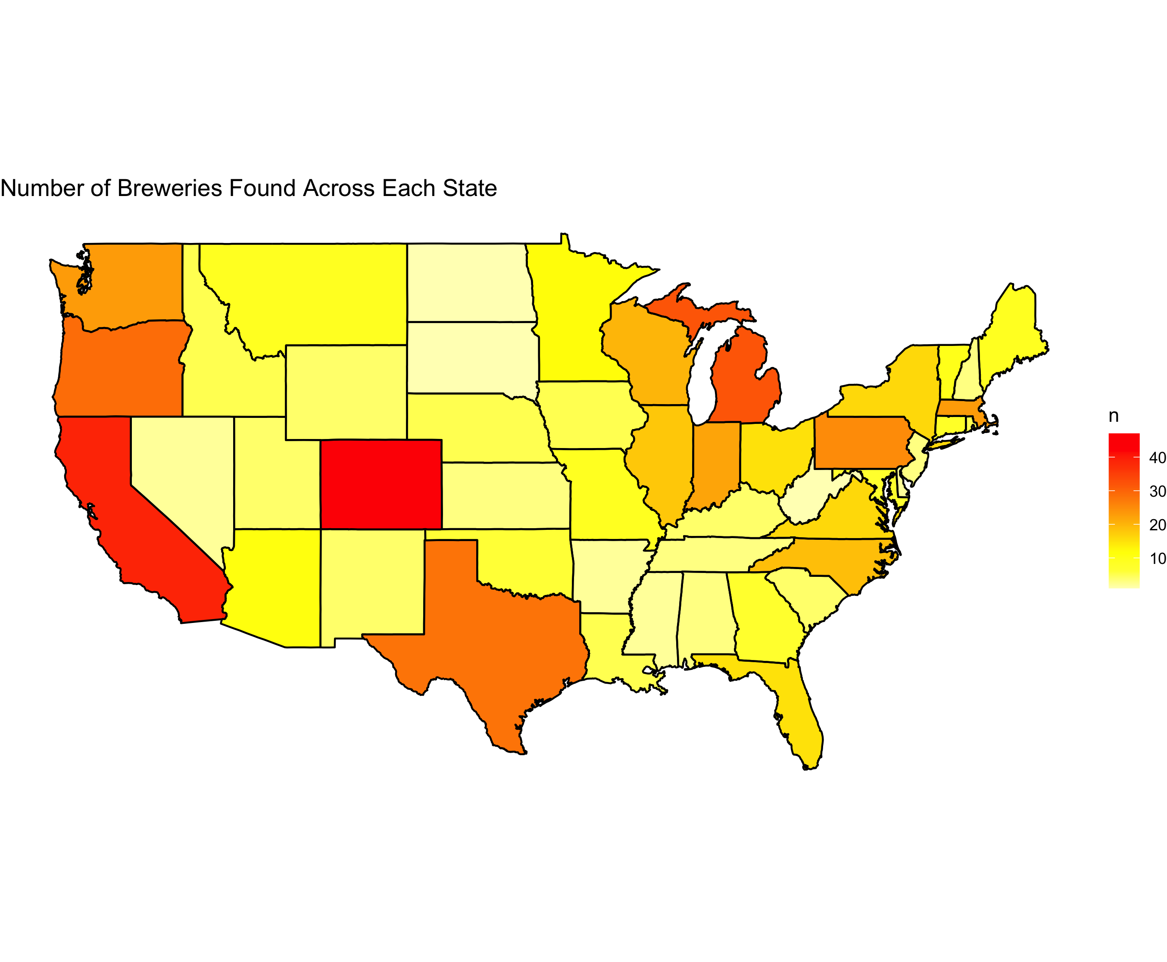
Breweries present in each state
Top 5 states:
Colorado (47)
California (39)
Michigan (32)
Oregon (29)
Texas (28)
Bottom 5 states:
DC (1)
North Dakota (1)
South Dakota (1)
West Virginia (1)
Arkansas (2)
Top 5 make up 32 % of all breweries

Slide 3
Key Missing Values
International bitterness unit (IBV) is unreported for 42% of the data
Percentage of Data Missing for Given Category
Beer | Beer_ID | ABV | IBU | Brewery_ID | Style | Ounces | Brewery | City | State
0% | 0% | 2.6% | 42% | 0% | 0.2% | 0% | 0% | 0% | 0%

